Slide 2
Using Microsoft SharePoint as a Communication Tool in Research Administration
Jennie Bell, Campus Effort Compliance Manager
Research and Sponsored Programs

Slide 3

Tip #1:
My main piece of advice to you –
just go for it!

Slide 4

Tip #2:
Start simple.

Slide 5

Tip #3:
Start by browsing the SharePoint site templates.
Think about your audience and how the site could be used.
Choose a template.

Slide 6
Examples of uses:
Monitor progress
Share data
Communicate information without emailing
Allow multiple contributors
Create a hub for up-to-date info

Slide 7

Tip #4
One SharePoint can handle different types of access.
For instance, you can manage access to folders on an individual level.

Slide 8

Tip #5:
Learn from my mistake.
Read up on how to invite participants / give access before you do so.

Slide 9
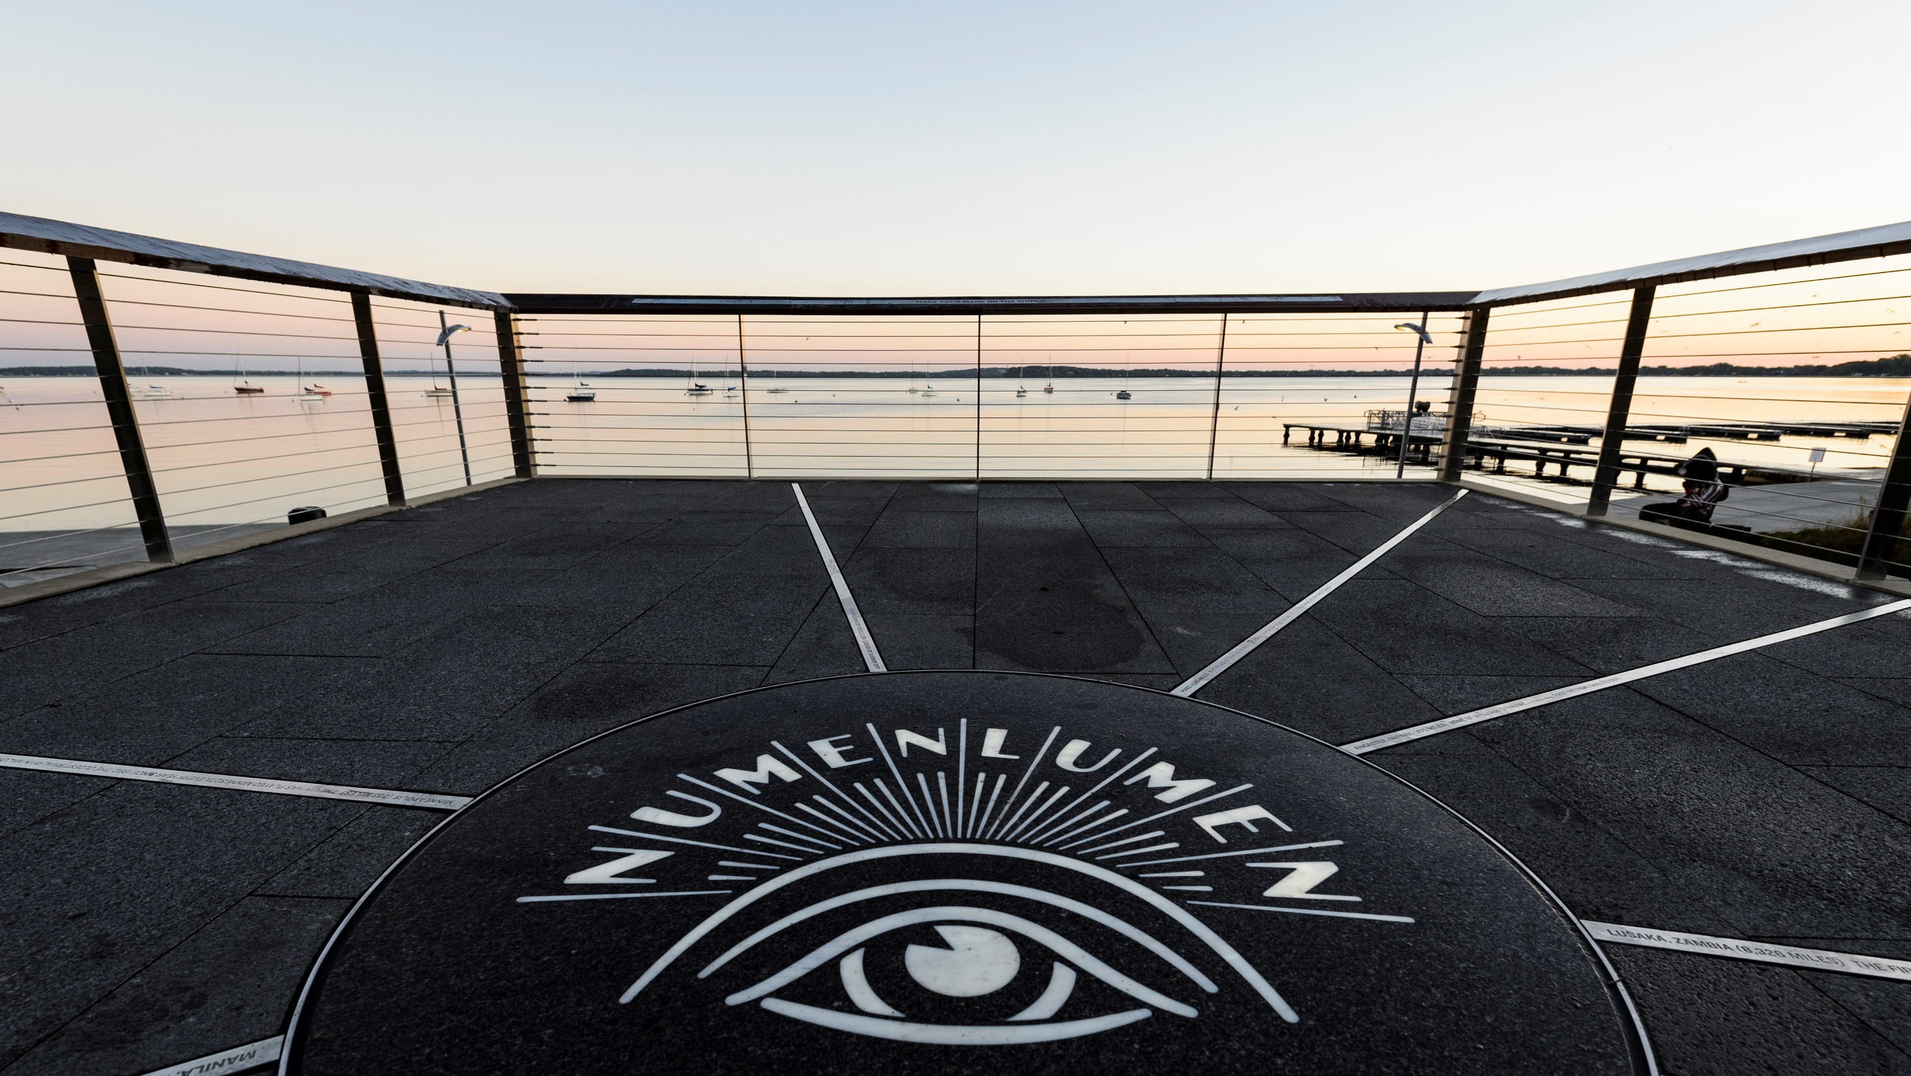
Tip #6:
Keeping the file name the same when you update and save a document saves time when uploading to SharePoint.

Slide 10

Tip #7
Be creative and have fun with it, if the situation allows.
Use the UW-Madison photo library on the Brand and Visual Identity webpage to make your site look great.
https://uwmadison-photos.photoshelter.com/index
https://brand.wisc.edu/visual-identity/photography/

Slide 11

Brainstorming discussion
Q&A

